Slide 1
Price Examples Weather Company Data Offerings

Slide 2
Weather Data Package Overview Core serves as the foundation, then add-on based upon business need
Application Use Example | Core | Enhanced Current Condition | Enhanced Forecast | Severe Weather | Lifestyle Indices | Cleaned Historical | Seasonal Forecast
Evaluating current weather conditions in context of customer specific situation
Focused on business outcomes influenced by predicted weather events & conditions
Focused on the impact of extreme weather events
Focused on the impact of weather on specific activities
Combine with customer data to find weather-dependent outcomes and train analytical models.
Focused on longer term weather trends and their impact on business outcomes.
Notes:
George
Remember, most customers purchase CORE plus one or MORE of the add on packages – some guidelines below:
For applications that are focused on evaluating current weather conditions in context of customer specific data or situations, customers should purchase the Core package to facilitate understanding of the current and near term weather environment, and the Enhanced Current Conditions package for precise and more frequent reporting on weather conditions happening now and in the recent past.
For applications that are focused on forecasting business outcomes influenced by predicted weather events and conditions, customers should purchase the Core package to facilitate understanding of the current and near term weather environment, and the Enhanced Forecast package for more precise near term forecast events and extended timeline outlooks.
For applications that focus on the impact of extreme weather events, customers should purchase the Core package to facilitate understanding of the current and near term weather environment, and the Severe Weather package for real time reporting and short term forecasting of the most severe weather phenomena and for trailing estimates of the geographical effects of the event.
The Lifestyle package should augment the Core package for informing on the impact of weather on specific activities or conditions. The Core package paints the base weather scenario and the Lifestyle package provides specific guidance building on the base weather.
Cleansed historical data is used to combine with customer data to find weather-dependent outcomes and train analytical models.
Seasonal forecast is really for customers focused on longer term weather trends and their impact on business outcomes.

Slide 3
Core Weather Data Package
Scope
Pricing
APIs
2-Day Hourly Forecast |  | Worldwide
Daily Forecast (3, 5, 7 & 10 day)
Intraday Forecast (3, 5, 7 & 10 day)
Site Based Observations
Time-Series Based Observations
Location Mapping Services
Monthly Almanac
Current Conditions and Forecast Imagery Layer
Weather Alert – Headlines & Details |  | U.S., Canada, Europe
Daily Almanac |  | U.S.
Radar & Satellite Layer | Radar Layer - Continental US, Alaska, Hawaii Radar Layer - Radar - North American Composite Radar Layer - Australia
# API calls [in M]* | Price Euro/ Month | Price Euro/ Annual
5 | € 809 | € 9.708
26
51
101
251
501
1,001
2,501
5,001
10,001
25,001
*API Call Description - Forecast APIs will return the amount of temporal data per location that the API call is written to fetch. For an example, if the API call is constructed to pull the 10-day daily forecast, one call will return today plus the next nine days for one location. The Site Based Observations API will return the current conditions for one location per API call. The Time-Series Based Observations API will return up to the last 24-hours of reported current conditions for one location per call. The Weather Alert APIs will return all active alerts for one location per call. The Almanac APIs will return either a daily or monthly summary for one location per call. Lastly, the Current Conditions and Forecast Imagery Layer and Radar & Satellite Layer will return one tile for one bounding-box location per call.
**Minimum monthly fee

Slide 4
Enhanced Current available fields
See separate file attached

Slide 5
Enhanced Current Conditions Weather Data Package
Pricing levels
Scope
Metric for this Weather Data Package is Revenue of customer.
Annual BU Revenue Euro [in M] | Price Euro/ Month | Price Euro/ Annual
€ 500 | *€ 605 | € 7.260
€ 1,001
€ 2,501
€ 5,001
€ 10,001
€ 25,001
*Minimum monthly fee

Slide 6
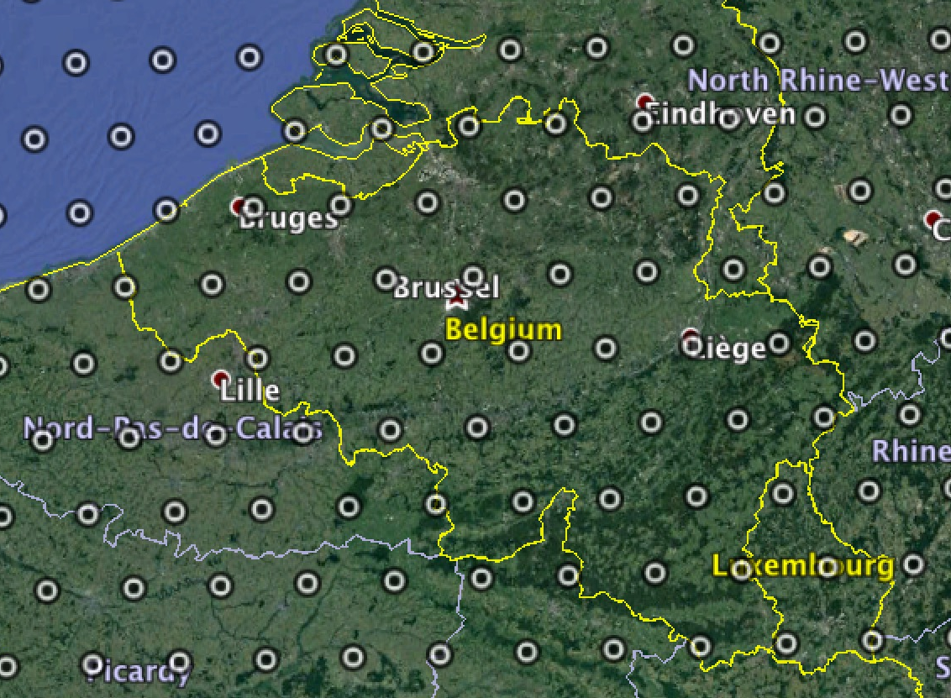
Cleaned Historical grid coverage for Belgium
Overview of 30km grid points for Belgium

Slide 7
Cleaned Historical – available fields
Name | Description
SiteId | Site / location identifier (either Virtual Grid Square ID or METAR ID)
dateHrGmt | Greenwich Mean Time (GMT) date-time (also known as Universal Time)
dateHrLwt | Valid local date-time (Local wall time {includes daylight savings time})
surfaceTemperatureFahrenheit | Surface air (dry bulb) temperature at 2 meters
surfaceDewpointTemperatureFahrenheit | Atmospheric humidity metric (temperature at which dew will form)
surfaceWetBulbTemperatureFahrenheit | Atmospheric humidity metric (evaporative cooling potential of moist surface)
relativeHumidity | Percent of water vapor in the air relative to its saturation point
apparentTemperatureFahrenheit | Air temperature that includes impact of wind and humidity
windChillTemperatureFahrenheit | Air temperature that includes impact of wind
precipitationPreviousHourInches | Liquid equivalent for types: warm rain, freezing rain, sleet, snow
surfaceAirPressureMillibars | Atmospheric pressure at the Surface
MslPressureMillibars | Mean Sea Level Pressure
cloudCoverage | Percentage of the sky covered by clouds
windSpeedMph | Unobstructed wind speed at 10 meters
windDirection | Upwind direction (e.g., wind from east = 270, from south = 180, etc.) at 10 meters
diffuseHorizontalRadiation | Diffuse (indirect) solar radiation flux on a plane parallel to the Earth's surface
directNormalIrradiance | Direct solar radiation flux on a surface 90 deg to the sun
downwardSolarRadiation | Total solar radiation flux on a plane parallel to the Earth's surface
surfaceTemperatureCelsius | Surface air (dry bulb) temperature at 2 meters
surfaceDewpointTemperatureCelsius | Atmospheric humidity metric (temperature at which dew will form)
surfaceWetBulbTemperatureCelsius | Atmospheric humidity metric (evaporative cooling potential of moist surface)
apparentTemperatureCelsius | Air temperature that includes impact of wind and humidity
windChillTemperatureCelsius | Air temperature that includes impact of wind
precipitationPreviousHourCentimeters | Liquid equivalent for types: warm rain, freezing rain, sleet, snow
surfaceAirPressureKilopascals | Atmospheric pressure
MslPressureKilopascals | Mean Sea Level Pressure
windSpeedKph | Unobstructed wind speed at 10 meters

Slide 8
Cleaned Historical Weather Data Package
Scope Belgium
Pricing Tiers – 12 month minimum
API
Cleaned Historical The Cleaned Historical package provides access to a variety of observed and derived historical meteorological parameters including temperature, dew point, air pressure, wind speed and direction, relative humidity, degree day variables, as well as a set of specialized variables including soil moisture, sea level pressure, wind gust, cloud cover and others. Variables are available by latitude/longitude or specific location code.
# API calls/ month [in Thousands]* | Price Euro/ Month | Price Euro/ Annual
403 | **€ 1,701 | € 20.408
806
1,612
4,030
10,000
15,500
40,300
77,500
161,200
Scope
Metric for Cleaned Historical Weather Data Package is #API calls (see definition in footnote) Requirements : Coverage only for Belgium: 42 grid points (30km2 grid) From 1981: = ((36 years times 53 weeks) + 10 weeks up to today )times 42 gridpoints = 80.556 API calls -> within the first tier of 403
*An API call will return up to 7-days of historical data for all available variables for one lat-lon/ location. For an example, if 28-days worth of historical data were pulled for one location, that would expend 4 API calls.
**Minimum monthly fee
With more API calls/month, a customised pricing model will be used.

Slide 9
Cleaned Historical Weather Data Package
Scope Europe or global
Pricing Tiers – 12 month minimum
API
Cleaned Historical The Cleaned Historical package provides access to a variety of observed and derived historical meteorological parameters including temperature, dew point, air pressure, wind speed and direction, relative humidity, degree day variables, as well as a set of specialized variables including soil moisture, sea level pressure, wind gust, cloud cover and others. Variables are available by latitude/longitude or specific location code.
# API calls/ month [in Thousands]* | Price Euro/ Month | Price Euro/ Annual
403
806
1,612
4,030
10,000 | € 9.620 | € 115.440
15,500
40,300
77,500
161,200 | € 27.290 | € 327.480
Scope
Metric for Cleaned Historical Weather Data Package is #API calls (see definition in footnote) Requirements USE case 2: Coverage EU: 4.980 grid points (30km2 grid) From 1981: = ((36 years times 53 weeks) + 10 weeks up to today )times 4.908 gridpoints = 9.236.856 API calls -> within tier of 10.000 Spatial coverage: global (80°N to 57°S): 600.000 grid points(30km2 grid) From 2014: (( 3 years times 53 weeks) + 10 weeks up to today) times 600.000 grid points = 101.400.000 API calls -> within the last tier
*An API call will return up to 7-days of historical data for all available variables for one lat-lon/ location. For an example, if 28-days worth of historical data were pulled for one location, that would expend 4 API calls.
**Minimum monthly fee
With more API calls/month, a customised pricing model will be used.

Slide 10
Why The Weather Company?
Global footprint
Industry-leading weather data coverage
Through a unique combination of >150 forecast models, The Weather Company can deliver hyperlocal, precise and on-demand forecasts
Industry Specific Data Packages e.g. for agriculture

Slide 11





Mapping The Atmosphere: a Big Data and IoT Approach To Precise Weather
Up to
2.2 Billion
weather forecast locations
15 Million
pressure readings from mobile devices
Atmospheric data from 50,000 flights per day
> 190,000 worldwide weather stations
> 150 forecast models
serve as inputs to forecast

Slide 12
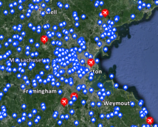
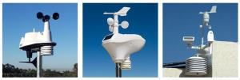
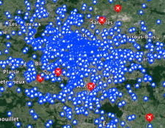
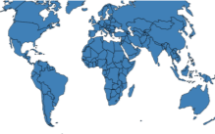
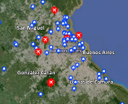
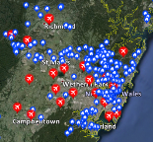
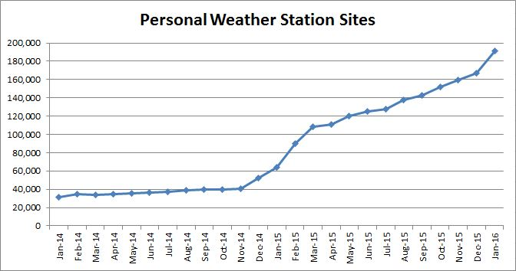

Through the Personal Weather Station Network of >190 000 sensors, The Weather Company offers industry-leading weather data coverage
Boston, USA
Personal weather sensors
Paris, France
Buenos Aires, Argentina
Sydney, Australia

Slide 13
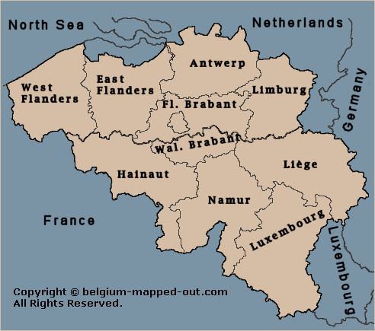
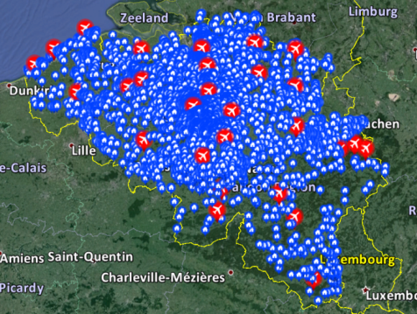
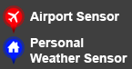
For example Weather Station Network – Belgium
2850 Personal Weather Stations in Belgium
28 Government Weather Stations
PWS report every 5 min / Government report every hour
Belgium Provinces
PWS + Government Stations
Public Sources vs.
The Weather Company Stations
Notes:
http://en.allmetsat.com/metar-taf/

Slide 14
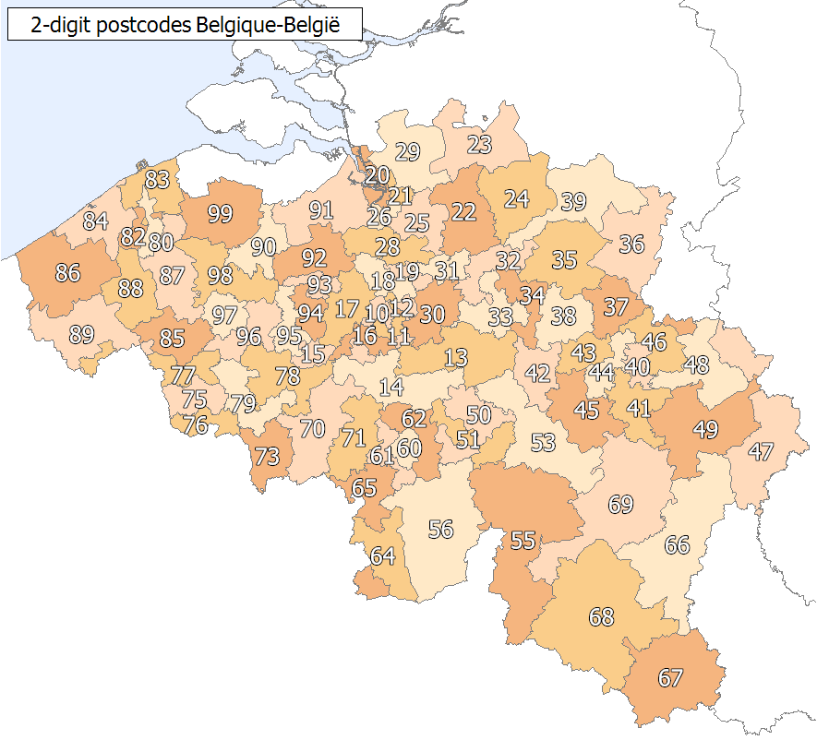
For example Personal Weather Station Network – Postal Code distribution in Belgium
Belgium Postal Codes
POSTAL CODE STATISTICS
Over 1140 Postal Codes in Belgium
60% of Postal Codes within 2 km of PWS
95% of Postal Codes within 5 km of PWS
HISTORICAL STATISTICS
70% of stations active since August 2015
40% of stations active January 2015
Additional PWS station data available back to January 2011
Government station data back to 1980
Notes:
http://en.allmetsat.com/metar-taf/

Slide 15
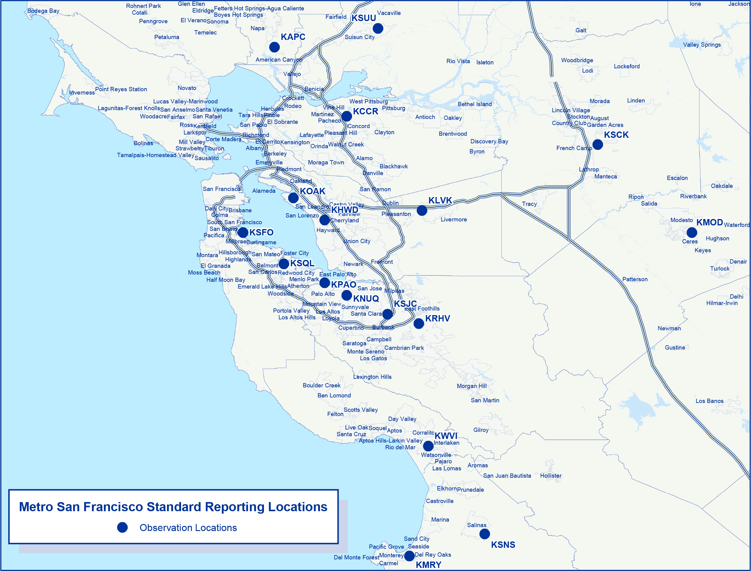
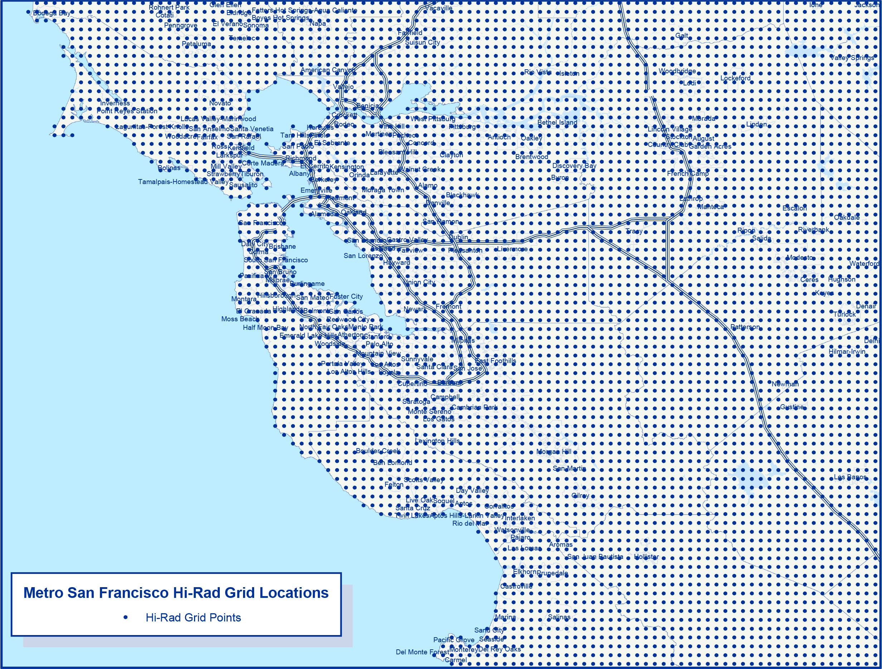

Through a unique combination of >150 forecast models, The Weather Company can deliver hyperlocal, precise and on-demand forecasts
Standard Observations
In The Past, Relatively Few Observation Locations
The Weather Company Forecast Grid
Forecasts: On Demand, Up To 2.2 Billion Precise Locations, Updated Every 15 Minutes

Slide 16




Media & Entertainment
Travel & Transportation
Energy & Utilities Oil & Gas
Agriculture
Insurance & Financial Services
Retail
Delivering Better Business Outcomes
DECISIONS
Weather Solutions & Use Cases
Notes:
Objective of slides 25 – 31 – Tell the story through USE CASES.
At the end of the day, the most precise, accurate data…at scale yields insights that drive better decisions...sooner, which lead to more favorable outcomes. Let’s take a look at some of the solutions The Weather Company offers and the use cases that show them in action.

Slide 17
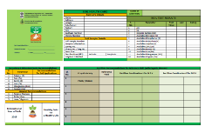





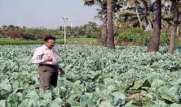
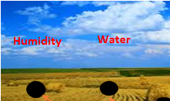




Agronomic business advisor for deep agricultural insights
Use Cases
Precision Fertilizer Application
Fertilizer requirements based on soil card information
GIS mapping of various crops and soil types
Analysis of fertilizer required at regional areas
Predictions and analysis
System for Crop Disease Identification
Identify diseases from image
Generate advisories for user
Regional warning system based on disease location analysis
Provide inputs to supply chain management
Fertilizer Application
Precision Irrigation
Crop Disease Identification
Sensor Integration
Recommendation Engine
Suggest best time for planting
Align crop profile with weather profile
Short and long term forecasts
Input parameters include fertilizer, water, insecticide, etc.
Sensors Integrated with Equipment
Automatic enablement of water dissipation units, fertilizers, etc.
Saves excess or deficient dissipation
Enhanced production with optimal dissipation
Innovations
Satellite Imagery
Vegetation Index
Soil Moisture Technology
Predictive Weather Analytics
Use agricultural insights to predict crop yields and understand impact on your financial and operational performance …

Slide 18
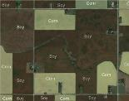


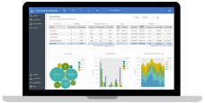
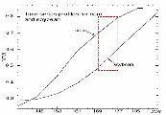


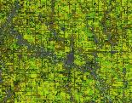
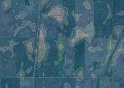


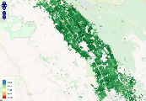
Potential client use cases based on agriculture data and advanced insight
Crop Data & Insight
Precision Ag Applications
Operational Use Cases
Based on Crop Yield Predictions
Plan to grow a crop
Seeding/ planting
Supply forecasting for raw materials in client products
Analyze impact of fluctuations in supply on ability to meet customer demand
Determine raw material supply’s impact on global commodities pricing
Use seasonal crop yield forecasts to determine hedging policies
Employ marketing and advertising campaigns to balance supply and demand
Explore commodity purchasing contracts with new suppliers
Employ product value engineering
Reduce indirect product costs via supply chain optimization
Nurture crop growth
Protect crop growth
Monitor/adjust crop growth
Harvest crop

